Slide 1
02
U-Code Technology
Optimized deep compression technology

Slide 2
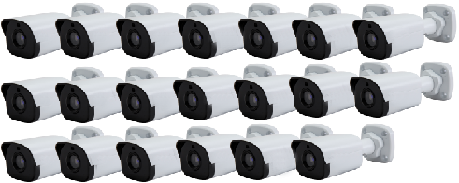
H.264
Ultra 265 Bandwidth-light
How many 2MP cameras can be carried by a 20Mb broadband network?
5-ch
20-ch
Basic Mode: Up to 25%-80% bandwidth reduction
Advanced Mode: Up to 80%-95% bandwidth reduction

Slide 3
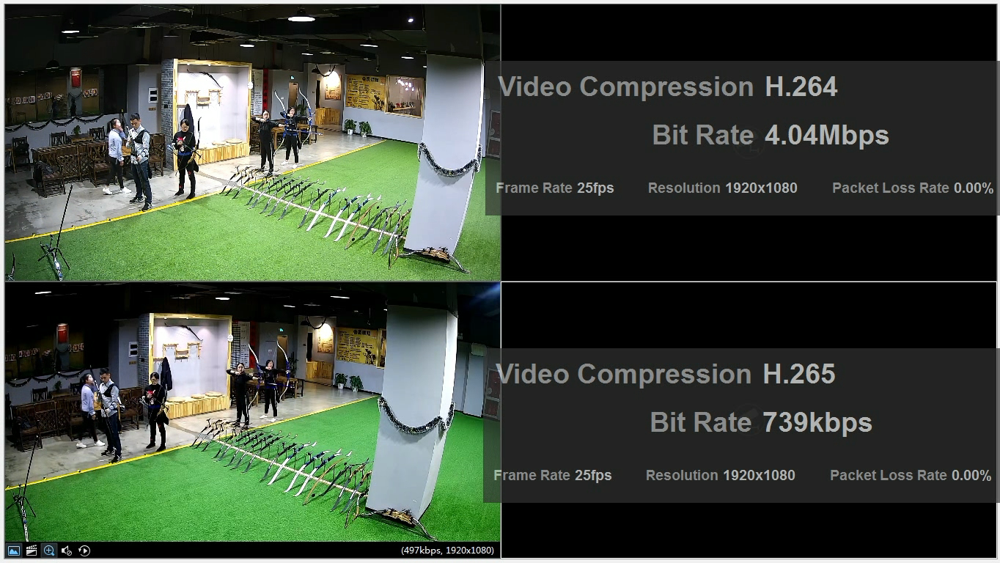
U-Code Image-fidelity
4Mbps bit rate down to 1Mbps or lower with movement, while keeping the same resolution and frame rate
Lossless
in Image Quality
at U-Code mode
*Advanced mode only works with IPC&VMS

Slide 4
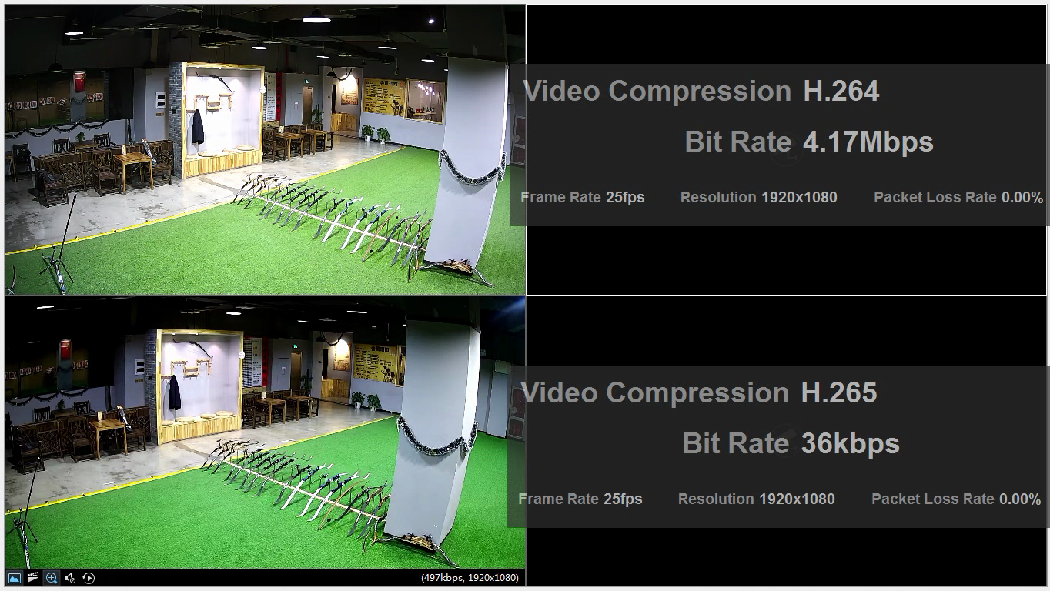
U-Code Image-fidelity
More compression in static image at the same resolution and frame rate
Lossless
in Image Quality
at U-Code mode
*Advanced mode only works with IPC&VMS

Slide 5
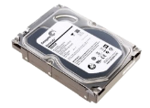
H.264
Ultra 265 Storage-save
How many hard disk needed to store 4-ch 2MP IPC for 3 month?
4T X 4
4T X 1
80%-95% Reduction in Storage
Three 4T disks saved!
400 saved !
Calculation conditions:
Resolution | H.264 | H.265 | Basic Ultra 265 | *Advanced Ultra 265
2MP | 4Mbps | 2Mbps | 1.5Mbps | 1Mbps
4K | 8Mbps | 4Mbps | 3Mbps | 2Mbps

Slide 6
H.264
Ultra 265 Storage-save
How long can one 4T HDD to store 1-ch 2MP IPC?
3 MONTHS
1 YEAR
80%-95% Reduction in Storage
Calculation conditions:
Resolution | H.264 | H.265 | Basic Ultra 265 | *Advanced Ultra 265
2MP | 4Mbps | 2Mbps | 1.5Mbps | 1Mbps
4K | 8Mbps | 4Mbps | 3Mbps | 2Mbps

