Slide 1
Ultra 265
More than a compression technology.
It is a Ultra 265 solution,
which significantly save your total cost.

Slide 2
The most advanced video compression technology in video surveillance
The deep video compression technology of Uniview to reduce the bitrate based on H.265
+
=
U-Code
Technology
H.265
Ultra 265
Control bitrate depending on the video content
Bitrate
control
Separate moving target and static background with different codec
Dynamic GOP
Deep
Video compression
Keep good image quality
Image quality

Slide 3
01
Smart Solution

Slide 4
Smart IPC
Audio exception
Face detection
Scene change
Auto tracking
Intrusion detection
Cross line detection
Defocus detection

Slide 5
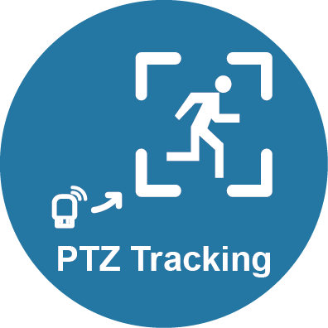
Alarm Trigger
Send an email
Upload to FTP
Start to SD record
Start to track
PTZ only
Output 0/1 signal
Take a snapshot
Call a preset
PTZ only

Slide 6
Event Record
Search record by smart events
Search snapshot for preview
Face detection
Intrusion detection
Scene change
Cross line detection
Audio exception
Defocus detection
Auto tracking

Slide 7
Enhanced Smart
ANPR (LPR)
Voice tracking
ANPR(LPR) in IP Camera
Entrance Management in NVR
3 microphones in fisheye
Track voice
People counting
Face recognition
Count people in IP Camera
Data statistics in NVR
Embedded Face recognition in Smart bar

Slide 8
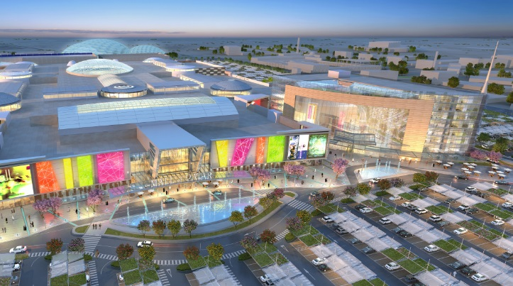
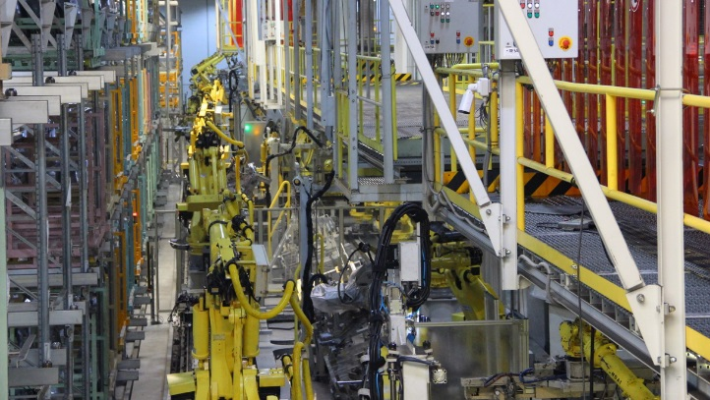
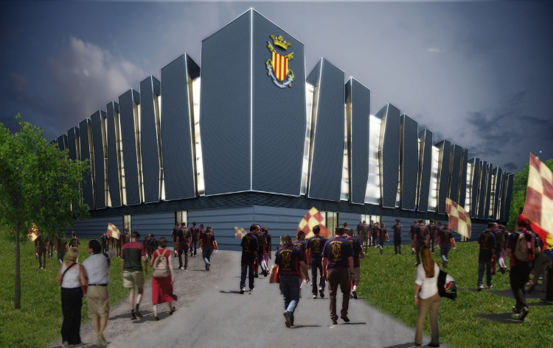
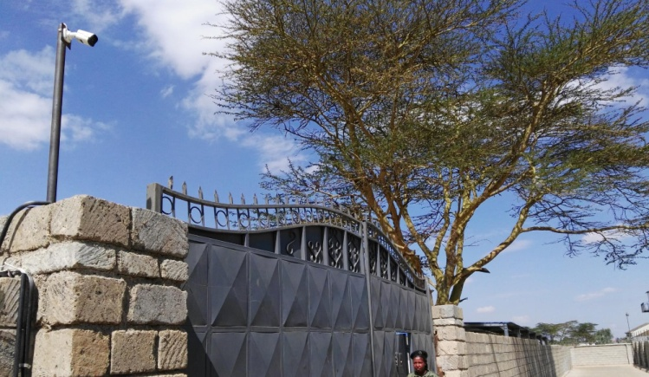
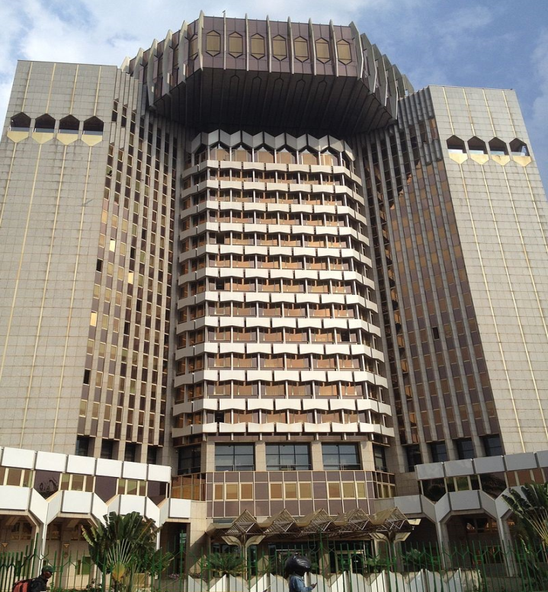
Mall of Qatar, Qatar
Hilton Hotels and Resorts, UAE
Gangnam District, Korea
Covered more than 105 countries
Kia Motors Factory, Slovakia
Sports Arena “Palacoccia”, Italy
Nairobi-Maroba Railway, Kenya
Gold Coast, Australia
Bank of Central African States , Cameroon

